Slide 1
https://github.com/ridingintraffic/docker-demo

Slide 2
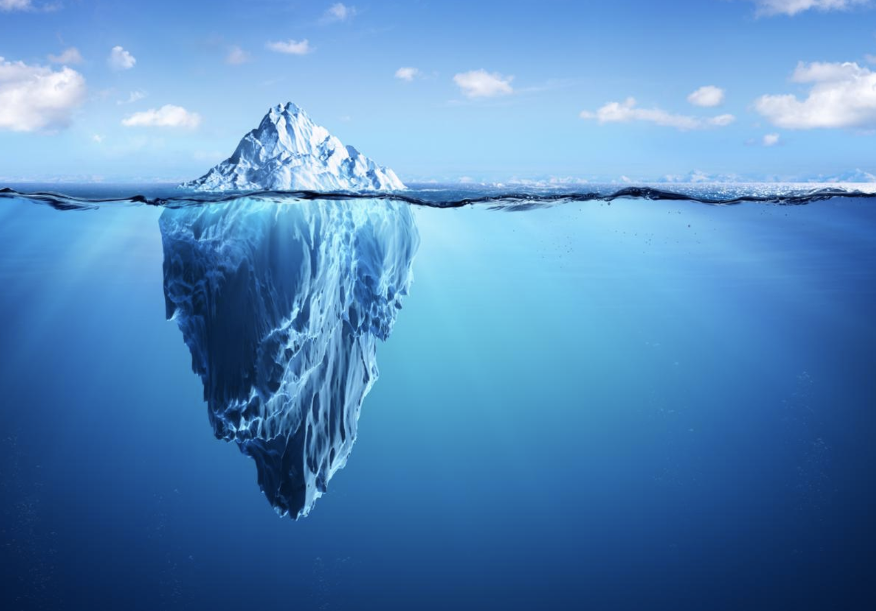
Notes:
Tip of the iceberg
There is no way to cover everything about docker in 45 min
This is a survery of what docker does , why it I useful and hopefully get some gears turning

Slide 3
Why Docker?
Identical Environments
Works on my machine
Quick turn around
12 Factor App Alignment https://12factor.net/
Notes:
Identical env
The same artifact can be deployed in dev it prod
Bug bounty program? Deploy there too
Want a “cyber range” ? – deploy and configure anywhere
Works on my machine, the nature of the portablility means that it will work the same on a laptop as it does on a server
Quick turn around: need a web server? Seconds to minutes
Need a Lamp stack same thing.
Best practices get baked in
12 fact app alignment: the nature of docker starts down the alignment - One codebase tracked in revision control, many deploys
Explicitly declare and isolate dependencies
Store config in the environment
- Strictly separate build and run stages
- Execute the app as one or more stateless processes
Maximize robustness with fast startup and graceful shutdown

Slide 4
What is Docker?
Containers
CPU, memory, network
NOT a vm
but similar
Overprovisionable, or can be limited
Layered structure
Notes:
Enough of the why.
What the heck is it?
The end product is a container
A container has CPU memory network and storage
Sounds like a VM, however its not, there are fundamental differences between the two.
Similar in that it can be overprovisoned , but it can also have strict limits on all resources.
Different in that there is not an entire VM spun up on the host machine, it is an isolated cgrouped set of resources.
It manifested it self as a runc binary running as a docker process
Fundamental difference is the layered nature that happens during Docker build time
Then the ability to publish state and be shared through public and private repos.
Layered structure has massive speed ups for iterative build process cycles
Contraining containers https://docs.docker.com/config/containers/resource_constraints/

Slide 5
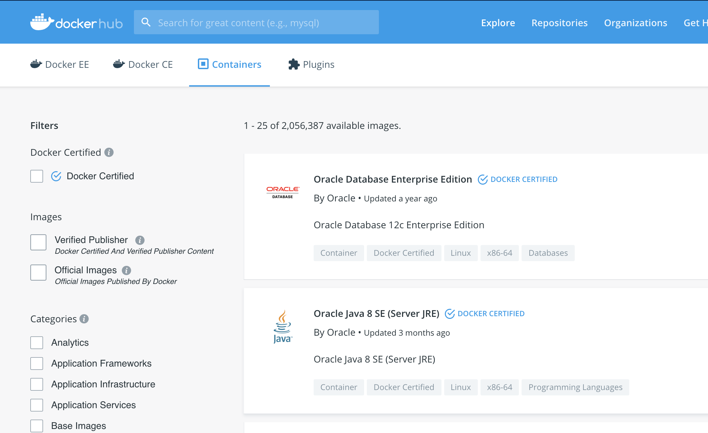
DockerHub : hub.docker.com
Use known images as base
Build from base
CentOS, Debian, Ubuntu, Windows
Lamp, Postgres, Splunk

Slide 6
Docker Applications
Apache web server
“Docker pull httpd”…. Profit
/app-apache

Slide 7

demo gods
Notes:
Salute the demo gods

Slide 8
Docker as a linux box
/centos

Slide 9
Docker as a python env
/python
/python/2.7
Volumes and sharing files
/python/3.8

Slide 10
Docker Toolbox CLI
Siem-ops

Slide 11
kali
asd

Slide 12
Links:
https://docs.docker.com/ free lab environment: https://labs.play-with-docker.com/
https://blog.docker.com/docker-weekly-archives/
https://blog.docker.com/
KALI: https://www.kali.org/news/official-kali-linux-docker-images/
Better kali booyaabes/kali-linux-full

